Slide 1
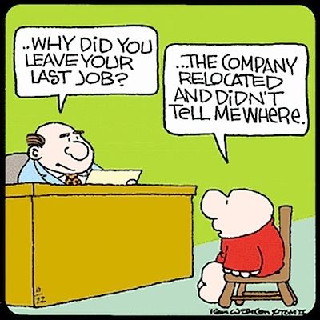
VGP104 - Software Development and Testing
Instructor: Peter Chan

Slide 2
Agenda
Introduction
Course Syllabus
Software Development Cycle
Typical C++ Development Environment
Rule #1 - Understand the System

Slide 3
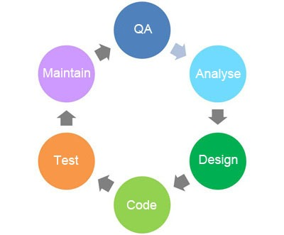
Software Development Cycle

Slide 4
Requirement Analysis
Customers typically have an abstract idea of what they want
Ideas might be incomplete, ambiguous, or even contradicting
Software engineers often need to make sure requirements are complete before execution
Test for Completion will also need to be defined to ensure requirements are satisfied

Slide 5
Design
Software Design is the process of problem solving
Includes low-level components and algorithm implementation issues as well as the architectural view
Often require research and brainstorming
Aspects to consider may include compatibility, extensibility, fault tolerance, maintainability, modularity, usability, reusability, robustness, efficiency and performance

Slide 6
Implementation
Writing source code and creating programs that perform specific operations
Can involve one or more programming languages
Requires expertise from different discipline

Slide 7
Testing
Investigation to provide information about the quality of the product and that it satisfies the requirements
Can be performed at different levels
Unit testing, integration testing, system testing, regression testing, stress testing, alpha, beta

Slide 8
Typical C++ Development Environment
Source code
Preprocessor
Compiler
Linker
Loader
CPU

Slide 9

Typical C++ Development Environment
Source code
Preprocessor
Compiler
Linker
HD
Loader
CPU

Slide 10
Source Code
Can be written using any text editor
Written in high level language such as C++
Usually held in one or more text files

Slide 11
Preprocessor
Prepare your source code for compilation
Interprets preprocessor directives such as, #include, #ifndef, #endif, etc

Slide 12
Compiler
Translate source code into low level machine language
Performs syntax checking and detects errors
Generates object files

Slide 13
Linker
Combines object files and resolves references
Reports any linkage problems
Generates an executable image, a static library, or a DLL

Slide 14
Loader
Takes the executable image from disk and transfers it to memory
Additional components from shared libraries that support the program are also loaded

Slide 15
Rule #1 - Understand the System
You have to understand how things are supposed to work before you can identify problems
Understanding the system also ensures that you don't introduce new problems when you are fixing bugs
Read the manual, read everything
Know how the systems interact with each other
Know your tools

